Slide 1
Module 4: Supplementary Slides (Optional, for Interested Students)

Slide 2
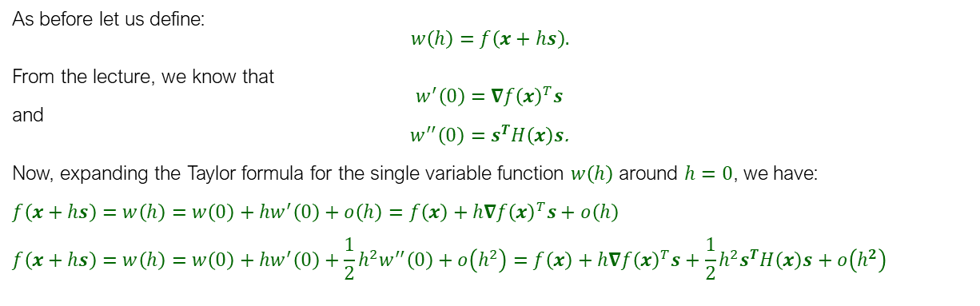

Obtaining Taylor Formula for Multivariable Functions
$$f\left(x+hs\right)=f\left(x\right)+h∇f{\left(x\right)}^{T}s+o\left(h\right)$$
$$f\left(x+hs\right)=f\left(x\right)+h∇f{\left(x\right)}^{T}s+\frac{1}{2}h^{2}s^{T}H\left(x\right)s+o\left(h^{2}\right)$$
As before let us define:
$$w\left(h\right)=f\left(x+hs\right).$$
From the lecture, we know that
$w^{′}\left(0\right)=$ $∇f{\left(x\right)}^{T}s$
and
$w^{′′}\left(0\right)=s^{T}H\left(x\right)s$.
Now, expanding the Taylor formula for the single variable function $w\left(h\right)$ around $h=0$, we have:
$$f\left(x+hs\right)=w\left(h\right)=w\left(0\right)+hw^{′}\left(0\right)+o\left(h\right)=f\left(x\right)+h∇f{\left(x\right)}^{T}s+o\left(h\right)$$
$$f\left(x+hs\right)=w\left(h\right)=w\left(0\right)+hw^{′}\left(0\right)+\frac{1}{2}h^{2}w^{′′}\left(0\right)+o\left(h^{2}\right)=f\left(x\right)+h∇f{\left(x\right)}^{T}s+\frac{1}{2}h^{2}s^{T}H\left(x\right)s+o\left(h^{2}\right)$$

Slide 3
Approximating a Multivariable Function

Slide 4
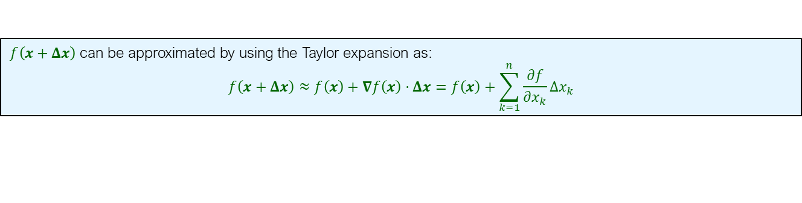

Approximating a Multivariable Function
$f\left(x+Δx\right)$ can be approximated by using the Taylor expansion as:
$$f\left(x+Δx\right)≈f\left(x\right)+∇f\left(x\right)⋅Δx=f\left(x\right)+\sum_{k=1}^{n}{\frac{∂f}{∂x_{k}}Δx_{k}}$$
Example: If $f\left(x,y\right)=ln\left(x\right)+ln(y)$, then approximate $f\left(1.06,1.02\right)$ using differentials.
Solution:
$f\left(x+Δx,y+Δy\right)≈f\left(x,y\right)+\frac{∂f}{∂x}$ $Δx+\frac{∂f}{∂y}Δy$
$$ln\left(x+Δx\right)+ln(y+Δy)≈[ln\left(x\right)+ln(y)]+\frac{1}{x}Δx+\frac{1}{y}Δy$$
$$ln\left(1.06\right)+ln\left(1.02\right)≈\left[ln\left(1\right)+ln\left(1\right)\right]+\frac{1}{1}\left(0.06\right)+\frac{1}{1}\left(0.02\right)=0.08$$

Slide 5
Matrix Calculus

Slide 6

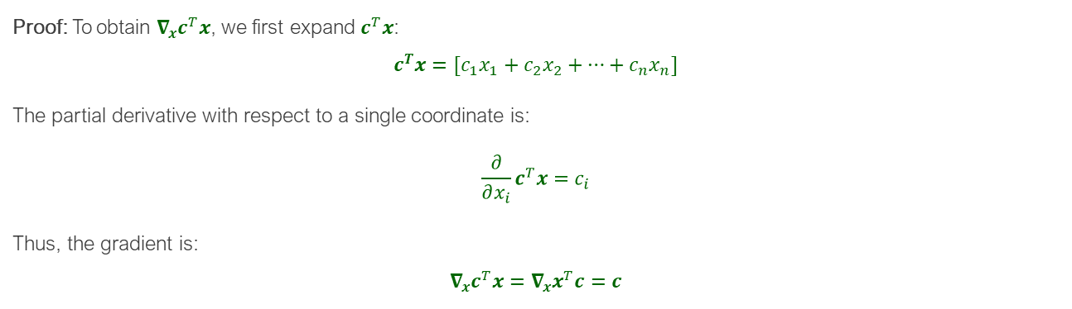
Matrix Calculus
Two Most Useful Results
Proposition 1: Let $x,c∈ℝ^{n×1}$. Then
$$\frac{∂}{∂x}{(c}^{T}x)=\frac{∂}{∂x}\left(x^{T}c\right)=c$$
Proof: To obtain $∇_{x}c^{T}x$, we first expand $c^{T}x$:
$$c^{T}x=[c_{1}x_{1}+c_{2}x_{2}+…+c_{n}x_{n}]$$
The partial derivative with respect to a single coordinate is:
$$\frac{∂}{∂x_{i}}c^{T}x=c_{i}$$
Thus, the gradient is:
$$∇_{x}c^{T}x=∇_{x}x^{T}c=c$$

Slide 7

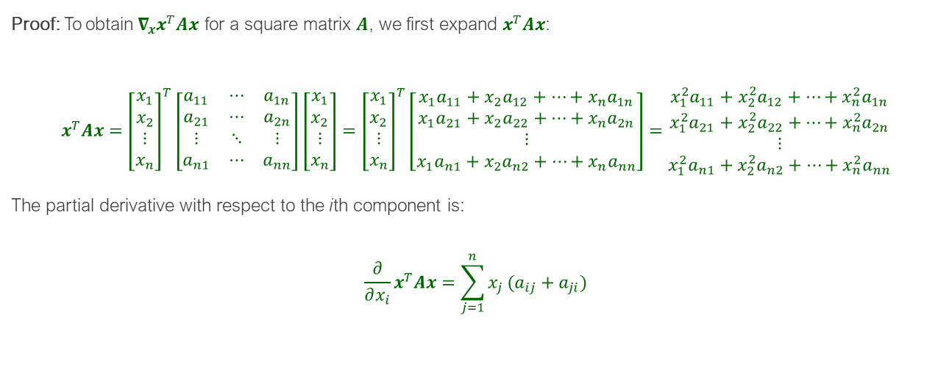
Matrix Calculus
Two Most Useful Results
Proposition 2: Let $x∈ℝ^{n×1}$and $A∈ℝ^{n×n}$. Then
$$\frac{∂x^{T}Ax}{∂x}=\left(A+A^{T}\right)x$$
Proof: To obtain$∇_{x}x^{T}Ax$ for a square matrix $A$, we first expand $x^{T}Ax$:
$$x^{T}Ax={\left[\begin{matrix}\begin{aligned}x_{1} \\ x_{2}\end{aligned} \\ ⋮ \\ x_{n}\end{matrix}\right]}^{T}\left[\begin{matrix}a_{11} & ⋯ & a_{1n} \\ a_{21} & ⋯ & a_{2n} \\ ⋮ & ⋱ & ⋮ \\ a_{n1} & ⋯ & a_{nn}\end{matrix}\right]\left[\begin{matrix}\begin{aligned}x_{1} \\ x_{2}\end{aligned} \\ ⋮ \\ x_{n}\end{matrix}\right]={\left[\begin{matrix}\begin{aligned}x_{1} \\ x_{2}\end{aligned} \\ ⋮ \\ x_{n}\end{matrix}\right]}^{T}\left[\begin{matrix}{x_{1}a}_{11}+{x_{2}a}_{12}+…+{x_{n}a}_{1n} \\ {x_{1}a}_{21}+{x_{2}a}_{22}+…+{x_{n}a}_{2n} \\ ⋮ \\ {x_{1}a}_{n1}+{x_{2}a}_{n2}+…+{x_{n}a}_{nn}\end{matrix}\right]=\begin{matrix}{x_{1}^{2}a}_{11}+{x_{2}^{2}a}_{12}+…+{x_{n}^{2}a}_{1n} \\ {x_{1}^{2}a}_{21}+{x_{2}^{2}a}_{22}+…+{x_{n}^{2}a}_{2n} \\ ⋮ \\ {x_{1}^{2}a}_{n1}+{x_{2}^{2}a}_{n2}+…+{x_{n}^{2}a}_{nn}\end{matrix}$$
The partial derivative with respect to the ith component is:
$$\frac{∂}{∂x_{i}}x^{T}Ax=\sum_{j=1}^{n}{x_{j}}(a_{ij}+a_{ji})$$

Slide 8

Matrix Calculus
Proof (continued): Thus, the gradient is:
$$∇_{x}x^{T}Ax=\left[\begin{matrix}\sum_{j=1}^{n}{x_{j}}(a_{1j}+a_{j1}) \\ \sum_{j=1}^{n}{x_{j}}(a_{2j}+a_{j2}) \\ ⋮ \\ \sum_{j=1}^{n}{x_{j}}(a_{nj}+a_{jn})\end{matrix}\right]=\left[\begin{matrix}a_{11}+a_{11} & a_{21}+a_{12} & ⋯ & a_{1n}+a_{n1} \\ {a_{12}+a}_{21} & a_{22}+a_{22} & ⋯ & {a_{n2}+a}_{2n} \\ ⋮ & ⋮ & ⋱ & ⋮ \\ {a_{1n}+ a}_{n1} & {a_{2n}+ a}_{n2} & ⋯ & {a_{nn}+a}_{nn}\end{matrix}\right]\left[\begin{matrix}\begin{aligned}x_{1} \\ x_{2}\end{aligned} \\ ⋮ \\ x_{n}\end{matrix}\right]=\left(A+A^{T}\right)x$$

Slide 9


Matrix Calculus
Other Helpful and General Results
Let $a∈ℝ, x, c∈ℝ^{n}, U\left(x\right),V\left(x\right),A∈ℝ^{n×n}.$ Then
$\frac{∂}{∂x}{(c}^{T}x)=\frac{∂}{∂x}(x^{T}c)=c$ (Proposition 1)
$\frac{∂x^{T}Ax}{∂x}=\left(A+A^{T}\right)x$ (Proposition 2)
$\frac{∂x^{T}x}{∂x}=2x$ (Special Case of Proposition 2)
$\frac{∂^{2}x^{T}Ax}{∂x∂x^{T}}=A+A^{T}$ (Resulting from using Prop 1 on Prop 2)
$\frac{∂c^{T}Ax}{∂x}=A^{T}c$ (Another representation of Proposition 1)
$\frac{∂a}{∂x}=0$ (Trivial result)
$\frac{∂}{∂x}\left(aU\left(x\right)\right)=a\frac{∂U\left(x\right)}{∂x}$ (Trivial result)
$\frac{∂}{∂x}(U(x)+V(x))=\frac{∂U(x)}{∂x}+\frac{∂V(x)}{∂x}$
$\frac{∂}{∂x}\left({U\left(x\right)}^{T}V\left(x\right)\right)=\frac{∂U\left(x\right)}{∂x}V\left(x\right)+\frac{∂V\left(x\right)}{∂x}U\left(x\right)$(Product rule)
$\frac{∂}{∂x}[{U\left(x\right)}^{T}AV\left(x\right)]=\frac{∂U\left(x\right)}{∂x}AV(x)+\frac{∂V\left(x\right)}{∂x}A^{T}V(x)$ (Product rule)
$\frac{∂}{∂x}(c^{T}U(x))=\frac{∂U(x)}{∂x}c$ (Generalization to Proposition 1)
$\frac{∂}{∂x}\left(c^{T}x^{T}cx\right)=\frac{∂}{∂x}\left({\left(xc\right)}^{T}cx\right)=2cc^{T}x$

Slide 10
Application of Matrix Calculus: Least Square Linear Regression

Slide 11
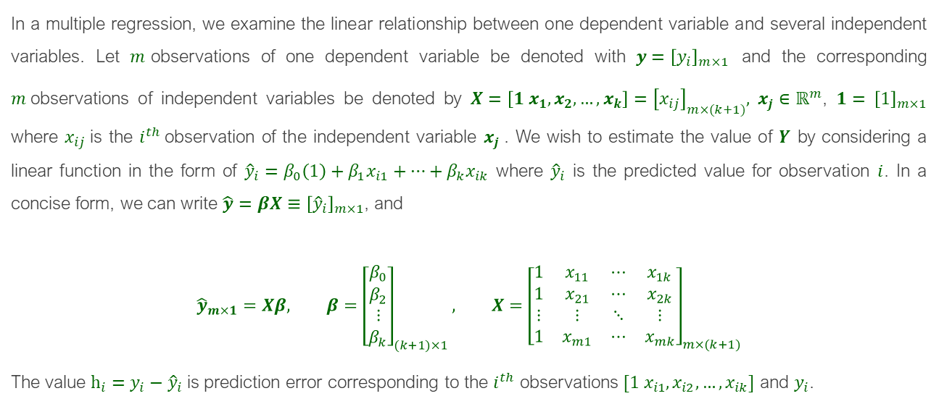
Linear Regression
In a multiple regression, we examine the linear relationship between one dependent variable and several independent variables. Let $m$observations of one dependent variable be denoted with $y={\left[y_{i}\right]}_{m×1}$ and the corresponding $m$observations of independent variables be denoted by $X=\left[1 x_{1}, x_{2},…,x_{k}\right]={\left[x_{ij}\right]}_{m×(k+1)},$ $x_{j}∈ℝ^{m}$, $1=$ ${\left[1\right]}_{m×1}$ where $x_{ij}$is the $i^{th}$observation of the independent variable $x_{j}$. We wish to estimate the value of $Y$ by considering a linear function in the form of ${\hat{y}}_{i}=β_{0}\left(1\right)+β_{1}x_{i1}+…+β_{k}x_{ik}$ where ${\hat{y}}_{i}$ is the predicted value for observation $i$. In a concise form, we can write $\hat{y}=βX≡{\left[{\hat{y}}_{i}\right]}_{m×1}$, and
$${\hat{y}}_{m×1}=Xβ, β={\left[\begin{matrix}\begin{aligned}β_{0} \\ β_{2}\end{aligned} \\ ⋮ \\ β_{k}\end{matrix}\right]}_{(k+1)×1}, X={\left[\begin{matrix}1 & x_{11} & ⋯ & x_{1k} \\ 1 & x_{21} & ⋯ & x_{2k} \\ ⋮ & ⋮ & ⋱ & ⋮ \\ 1 & x_{m1} & ⋯ & x_{mk}\end{matrix}\right]}_{m×(k+1)}$$
The value $h_{i}=y_{i}−{\hat{y}}_{i}$ is prediction error corresponding to the $i^{th}$ observations$[1 x_{i1},x_{i2},…,x_{ik}]$ and $y_{i}$.

Slide 12
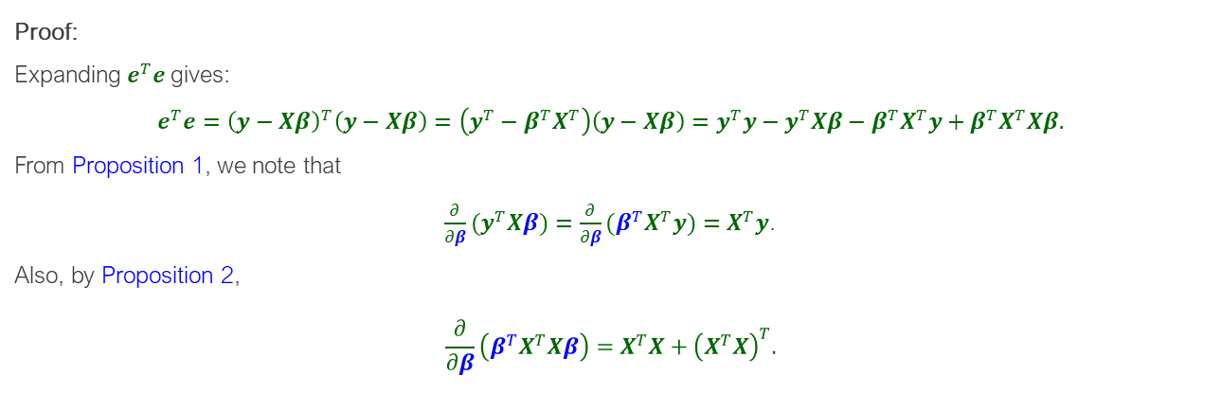

Linear Regression
Ordinary Least Squares Regression (OLS): The OLS regression line is the linear function$\hat{y}=Xβ$ that minimizes the sum of squared error values, i.e.,$\min_{β∈ℝ^{k}} \left(e^{T}e\right),e=y−Xβ.$ The OLS regression line coefficient vector is given by:
$$β^{∗}={\left(X^{T}X\right)}^{−1}X^{T}y.$$
Proof:
Expanding $e^{T}e$gives:
$$e^{T}e={\left(y−Xβ\right)}^{T}\left(y−Xβ\right)=\left(y^{T}−β^{T}X^{T}\right)\left(y−Xβ\right)=y^{T}y−y^{T}Xβ−β^{T}X^{T}y+β^{T}X^{T}Xβ.$$
From Proposition 1, we note that
${\frac{∂}{∂β}(y}^{T}Xβ)=\frac{∂}{∂β}(β^{T}X^{T}y)=X^{T}y$.
Also, by Proposition 2,
$$\frac{∂}{∂β}\left(β^{T}X^{T}Xβ\right)=X^{T}X+{\left(X^{T}X\right)}^{T}.$$

Slide 13
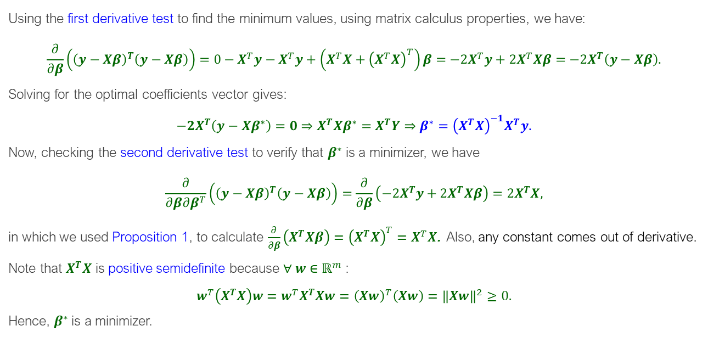
Linear Regression
Using the first derivative test to find the minimum values, using matrix calculus properties, we have:
$$\frac{∂}{∂β}\left({\left(y−Xβ\right)}^{T}\left(y−Xβ\right)\right)=0−X^{T}y−X^{T}y+\left(X^{T}X+{\left(X^{T}X\right)}^{T}\right)β=−2X^{T}y+2X^{T}Xβ=−2X^{T}\left(y−Xβ\right).$$
Solving for the optimal coefficients vector gives:
$$−2X^{T}\left(y−Xβ^{∗}\right)=0⇒X^{T}Xβ^{∗}=X^{T}Y⇒β^{∗}={\left(X^{T}X\right)}^{−1}X^{T}y.$$
Now, checking the second derivative test to verify that $β^{∗}$ is a minimizer, we have
$$\frac{∂}{∂β∂β^{T}}\left({\left(y−Xβ\right)}^{T}\left(y−Xβ\right)\right)=\frac{∂}{∂β}\left(−2X^{T}y+2X^{T}Xβ\right)=2X^{T}X,$$
in which we used Proposition 1, to calculate $\frac{∂}{∂β}\left(X^{T}Xβ\right)={\left(X^{T}X\right)}^{T}=X^{T}X$. Also, any constant comes out of derivative.
Note that $X^{T}X$ is positive semidefinite because $∀ w∈ℝ^{m}$:
$$w^{T}\left(X^{T}X\right)w=w^{T}X^{T}Xw={\left(Xw\right)}^{T}\left(Xw\right)={\left\|Xw\right\|}^{2}≥0.$$
Hence, $β^{∗}$ is a minimizer.

Slide 14
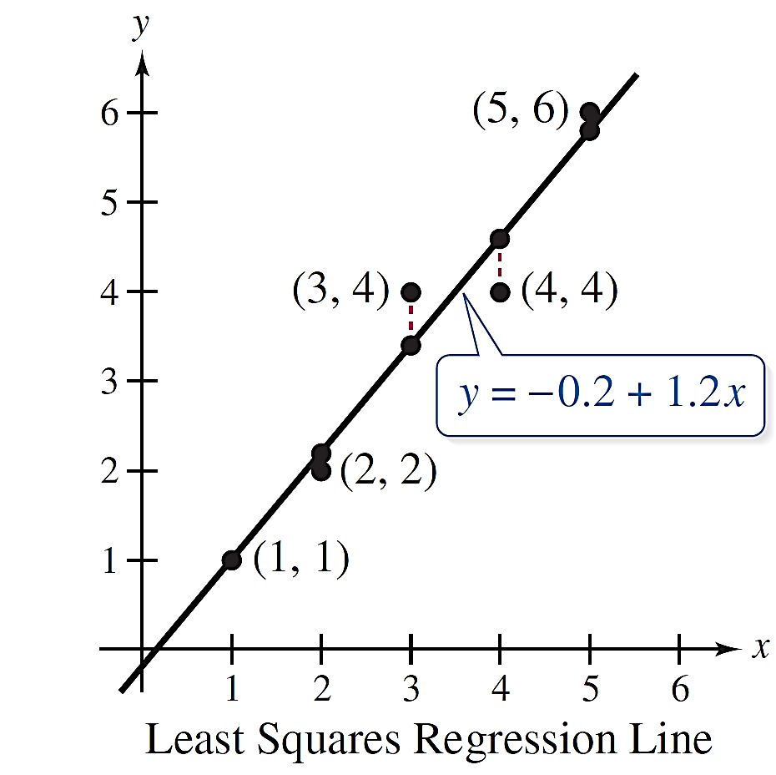

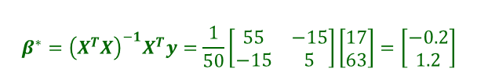
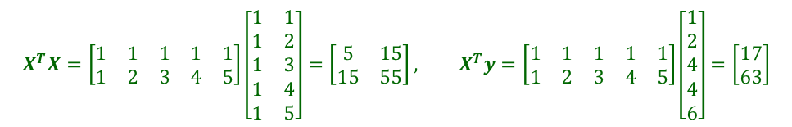
Linear Regression
Example
Find the linear regression line for the points $\left(1,1\right), \left(2,2\right),\left(3,4\right),\left(4,4\right),(5,6)$.
Solution.
The matrices $X$ and $y$ are $X=\left[\begin{matrix}1 & 1 \\ 1 & 2 \\ 1 & 3 \\ 1 & 4 \\ 1 & 5\end{matrix}\right], y=\left[\begin{matrix}1 \\ 2 \\ 4 \\ 4 \\ 6\end{matrix}\right]$
Hence, the least squares regression line is $y=−0.2+1.2x$.
$$X^{T}X=\left[\begin{matrix}1 & 1 & 1 & 1 & 1 \\ 1 & 2 & 3 & 4 & 5\end{matrix}\right]\left[\begin{matrix}1 & 1 \\ 1 & 2 \\ 1 & 3 \\ 1 & 4 \\ 1 & 5\end{matrix}\right]=\left[\begin{matrix}5 & 15 \\ 15 & 55\end{matrix}\right], X^{T}y=\left[\begin{matrix}1 & 1 & 1 & 1 & 1 \\ 1 & 2 & 3 & 4 & 5\end{matrix}\right]\left[\begin{matrix}1 \\ 2 \\ 4 \\ 4 \\ 6\end{matrix}\right]=\left[\begin{matrix}17 \\ 63\end{matrix}\right]$$
$$β^{∗}={\left(X^{T}X\right)}^{−1}X^{T}y=\frac{1}{50}\left[\begin{matrix}55 & −15 \\ −15 & 5\end{matrix}\right]\left[\begin{matrix}17 \\ 63\end{matrix}\right]=\left[\begin{matrix}−0.2 \\ 1.2\end{matrix}\right]$$

Slide 15
Constrained Optimization KKT Conditions for Multiple Constraints

Slide 16
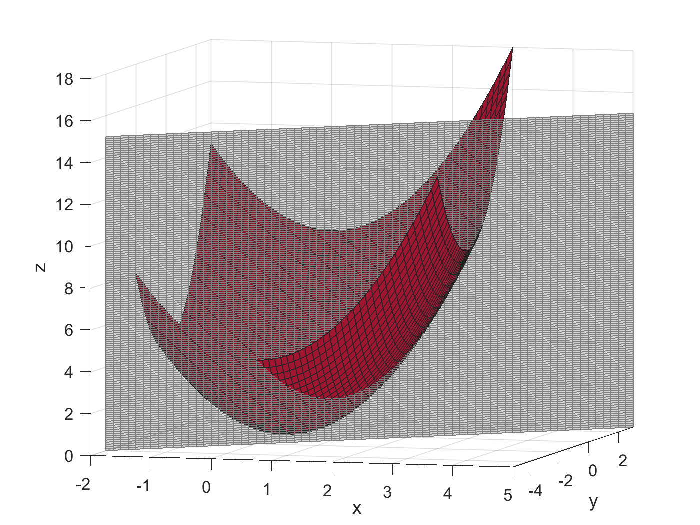



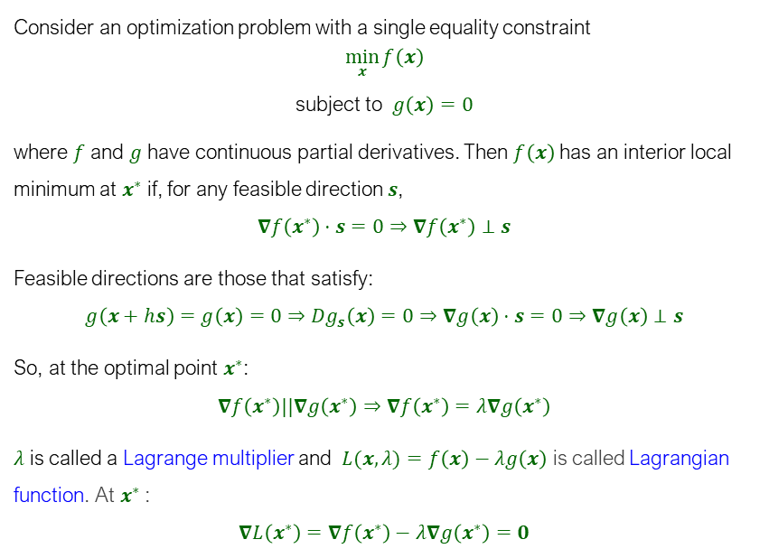



Equality Constraint
$$f\left(x\right)$$
Proof for One Constraint Using Gradients
$$g\left(x\right)=0$$
Consider an optimization problem with a single equality constraint
$$\min_{x}{f\left(x\right)}$$
subject to $g\left(x\right)=0$
where $f$ and $g$ have continuous partial derivatives. Then $f\left(x\right)$ has an interior local minimum at $x^{∗}$ if, for any feasible direction $s$,
$$∇f\left(x^{∗}\right)⋅s=0⇒∇f\left(x^{∗}\right)⊥s$$
Feasible directions are those that satisfy:
$$g\left(x+hs\right)=g\left(x\right)=0⇒{Dg}_{s}\left(x\right)=0⇒∇g\left(x\right)⋅s=0⇒∇g\left(x\right)⊥s$$
So, at the optimal point $x^{∗}$:
$$∇f\left(x^{∗}\right)||∇g\left(x^{∗}\right)⇒∇f\left(x^{∗}\right)=λ∇g\left(x^{∗}\right)$$
$λ$ is called a Lagrange multiplier and $L(x,λ)=f\left(x\right)−λg\left(x\right)$ is called Lagrangian function. At $x^{∗}$:
$$∇L\left(x^{∗}\right)=∇f\left(x^{∗}\right)−λ∇g\left(x^{∗}\right)=0$$
$$∇f\left(x\right)$$
$$−s$$
$$s$$
$$∇g\left(x\right)$$

Slide 17
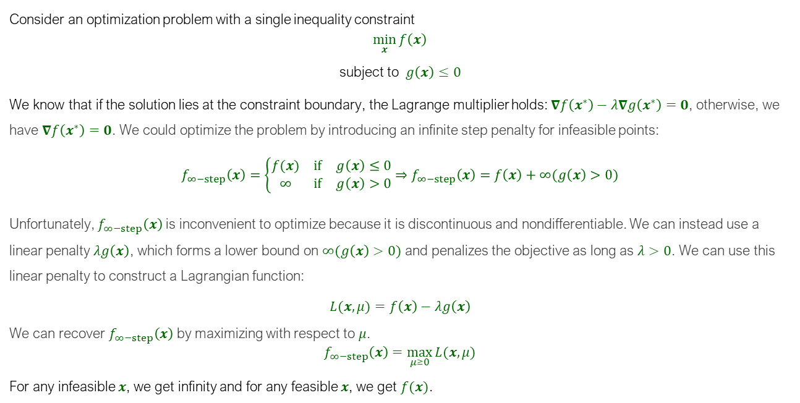
Inequality Constraints
Consider an optimization problem with a single inequality constraint
$$\min_{x}{f\left(x\right)}$$
subject to $g\left(x\right)≤0$
We know that if the solution lies at the constraint boundary, the Lagrange multiplier holds: $∇f\left(x^{∗}\right)−λ∇g\left(x^{∗}\right)=0$, otherwise, we have $∇f\left(x^{∗}\right)=0$. We could optimize the problem by introducing an infinite step penalty for infeasible points:
$$f_{∞−step}\left(x\right)=\left\{\begin{matrix}f(x) & if & g\left(x\right)≤0 \\ ∞ & if & g\left(x\right)>0\end{matrix}\right.⇒f_{∞−step}\left(x\right)=f\left(x\right)+∞(g\left(x\right)>0)$$
Unfortunately, $f_{∞−step}\left(x\right)$ is inconvenient to optimize because it is discontinuous and nondifferentiable. We can instead use a linear penalty $λg\left(x\right)$, which forms a lower bound on $∞(g\left(x\right)>0)$ and penalizes the objective as long as $λ>0$. We can use this linear penalty to construct a Lagrangian function:
$L(x,μ)=f\left(x\right)−λg\left(x\right)$
We can recover $f_{∞−step}\left(x\right)$ by maximizing with respect to $μ$.
$$f_{∞−step}\left(x\right)=\max_{μ≥0}{L(x,μ)}$$
For any infeasible $x$, we get infinity and for any feasible $x$, we get $f(x)$.

Slide 18
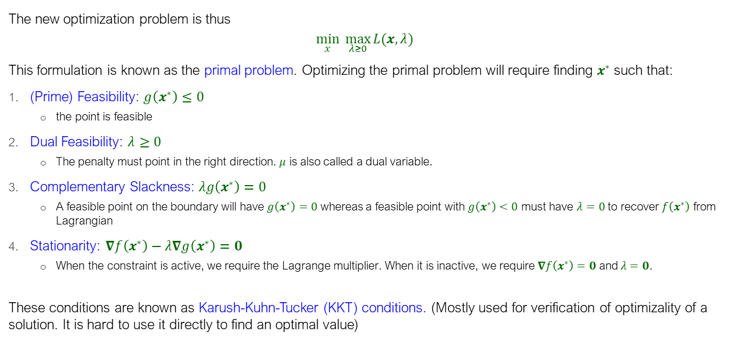
Inequality Constraints
KKT Conditions
The new optimization problem is thus
$$\min_{x} \max_{λ≥0}{L(x,λ)}$$
This formulation is known as the primal problem. Optimizing the primal problem will require finding $x^{∗}$ such that:
(Prime) Feasibility: $g\left(x^{∗}\right)≤0$
the point is feasible
Dual Feasibility: $λ≥0$
The penalty must point in the right direction. $μ$ is also called a dual variable.
Complementary Slackness: $λg\left(x^{∗}\right)=0$
A feasible point on the boundary will have $g\left(x^{∗}\right)=0$ whereas a feasible point with $g\left(x^{∗}\right)<0$ must have $λ=0$ to recover $f\left(x^{∗}\right)$ from Lagrangian
Stationarity: $∇f\left(x^{∗}\right)−λ∇g\left(x^{∗}\right)=0$
When the constraint is active, we require the Lagrange multiplier. When it is inactive, we require $∇f\left(x^{∗}\right)=0$ and $λ=0$.
These conditions are known as Karush-Kuhn-Tucker (KKT) conditions. (Mostly used for verification of optimizality of a solution. It is hard to use it directly to find an optimal value)

Slide 19
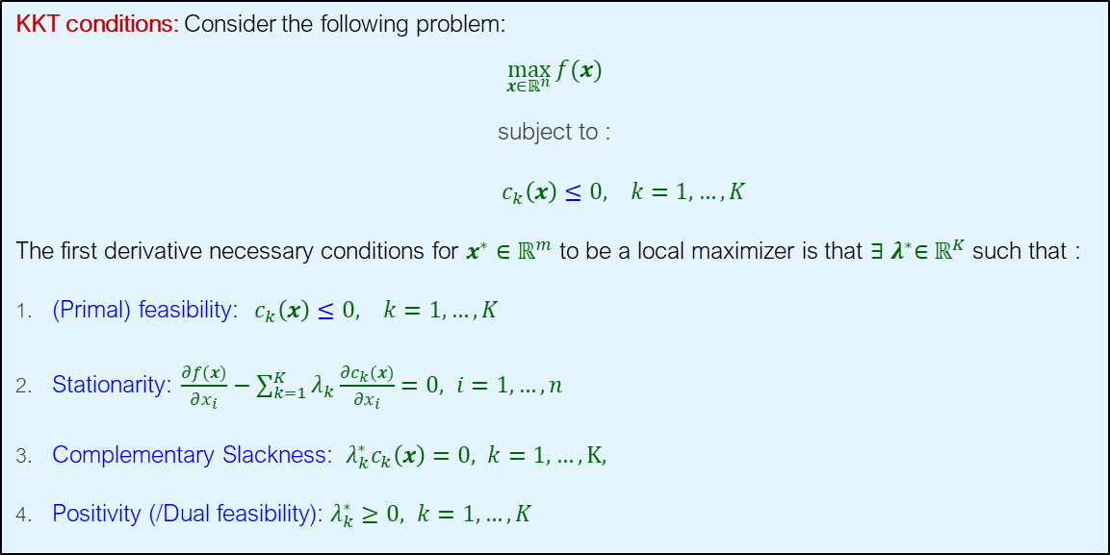
Constrained Optimization
KKT Conditions For Multiple Constraints
KKT conditions: Consider the following problem:
$\max_{x∈ℝ^{n}}{f(x)}$
subject to :
$c_{k}\left(x\right)≤0, k=1,…,K$
The first derivative necessary conditions for $x^{∗}∈ℝ^{m}$ to be a local maximizer is that ${∃ λ}^{∗}∈ℝ^{K}$ such that :
(Primal) feasibility: $c_{k}\left(x\right)≤0, k=1,…,K$
Stationarity: $\frac{∂f(x)}{∂x_{i}}−\sum_{k=1}^{K}{λ_{k}\frac{∂c_{k}(x)}{∂x_{i}}}=0, i=1,…,n$
Complementary Slackness: ${ λ}_{k}^{∗}c_{k}\left(x\right)=0, k=1,…,K,$
Positivity (/Dual feasibility): $λ_{k}^{∗}≥0, k=1,…,K$

Slide 20
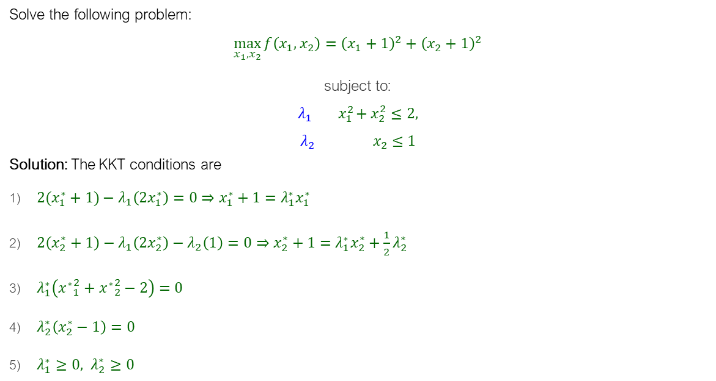
KKT Conditions For Multiple Constraints
Example
Solve the following problem:
$\max_{x_{1},x_{2}}{f\left(x_{1},x_{2}\right)}={\left(x_{1}+1\right)}^{2}+{\left(x_{2}+1\right)}^{2}$
subject to:
$$λ_{1} { x}_{1}^{2}+x_{2}^{2}≤2,$$
$$λ_{2} x_{2}≤1$$
Solution: The KKT conditions are
$2(x_{1}^{∗}+1)−λ_{1}\left(2x_{1}^{∗}\right)=0⇒x_{1}^{∗}+1=λ_{1}^{∗}x_{1}^{∗}$
$2\left(x_{2}^{∗}+1\right)−λ_{1}\left(2x_{2}^{∗}\right)−λ_{2}\left(1\right)=0⇒x_{2}^{∗}+1=λ_{1}^{∗}x_{2}^{∗}+\frac{1}{2}λ_{2}^{∗}$
$λ_{1}^{∗}\left({x^{∗}}_{1}^{2}+{x^{∗}}_{2}^{2}−2\right)=0$
$λ_{2}^{∗}\left(x_{2}^{∗}−1\right)=0$
$λ_{1}^{∗}≥0, λ_{2}^{∗}≥0$

Slide 21
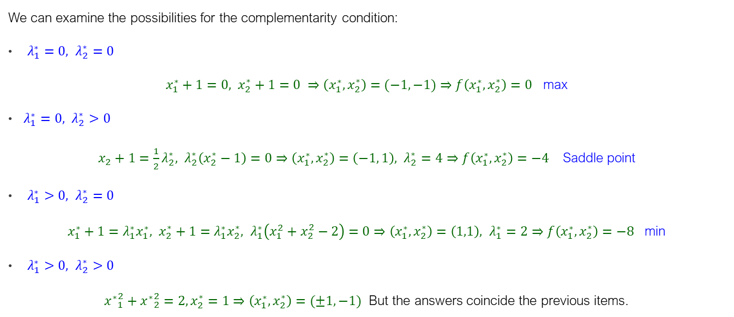
KKT Conditions For Multiple Constraints
Solution
We can examine the possibilities for the complementarity condition:
$λ_{1}^{∗}=0, λ_{2}^{∗}=0$
$x_{1}^{∗}+1=0, x_{2}^{∗}+1=0 ⇒\left(x_{1}^{∗},x_{2}^{∗}\right)=(−1,−1)⇒f\left(x_{1}^{∗},x_{2}^{∗}\right)=0$ max
$λ_{1}^{∗}=0, λ_{2}^{∗}>0$
$x_{2}+1=\frac{1}{2}λ_{2}^{∗}, λ_{2}^{∗}\left(x_{2}^{∗}−1\right)=0⇒\left(x_{1}^{∗},x_{2}^{∗}\right)=\left(−1, 1\right), λ_{2}^{∗}=4⇒f\left(x_{1}^{∗},x_{2}^{∗}\right)=−4$ Saddle point
$λ_{1}^{∗}>0, λ_{2}^{∗}=0$
$x_{1}^{∗}+1=λ_{1}^{∗}x_{1}^{∗}, x_{2}^{∗}+1=λ_{1}^{∗}x_{2}^{∗}, λ_{1}^{∗}\left(x_{1}^{2}+x_{2}^{2}−2\right)=0⇒\left(x_{1}^{∗},x_{2}^{∗}\right)=\left(1,1\right), λ_{1}^{∗}=2⇒f\left(x_{1}^{∗},x_{2}^{∗}\right)=−8$ min
$λ_{1}^{∗}>0, λ_{2}^{∗}>0$
${x^{∗}}_{1}^{2}+{x^{∗}}_{2}^{2}=2,x_{2}^{∗}=1⇒\left(x_{1}^{∗},x_{2}^{∗}\right)=(±1,−1)$ But the answers coincide the previous items.

Slide 22
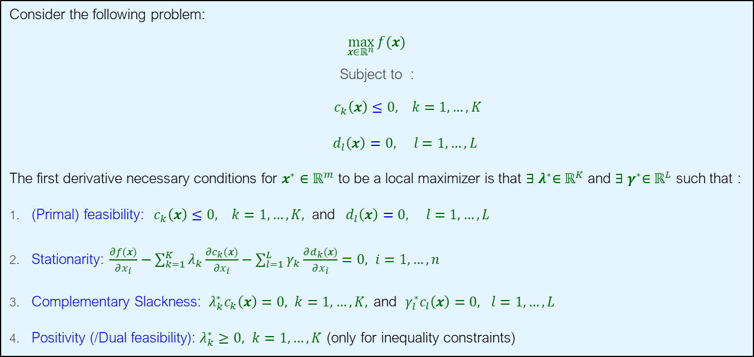
KKT Conditions For Multiple Equality and Inequality Constraints
Consider the following problem:
$\max_{x∈ℝ^{n}}{f(x)}$
Subject to :
$c_{k}\left(x\right)≤0, k=1,…,K$
$d_{l}\left(x\right)=0, l=1,…,L$
The first derivative necessary conditions for $x^{∗}∈ℝ^{m}$ to be a local maximizer is that ${∃ λ}^{∗}∈ℝ^{K}$ and ${∃ γ}^{∗}∈ℝ^{L}$ such that :
(Primal) feasibility: $c_{k}\left(x\right)≤0, k=1,…,K, \text{and} d_{l}\left(x\right)=0, l=1,…,L$
Stationarity: $\frac{∂f(x)}{∂x_{i}}−\sum_{k=1}^{K}{λ_{k}\frac{∂c_{k}(x)}{∂x_{i}}}−\sum_{l=1}^{L}{γ_{k}\frac{∂d_{k}(x)}{∂x_{i}}}=0, i=1,…,n$
Complementary Slackness: ${ λ}_{k}^{∗}c_{k}\left(x\right)=0, k=1,…,K, \text{and} γ_{l}^{∗}c_{l}\left(x\right)=0, l=1,…,L$
Positivity (/Dual feasibility): $λ_{k}^{∗}≥0, k=1,…,K$ $\text{(}\text{only} \text{for} \text{inequality} \text{constraints}\text{)}$

Slide 23
Additional Examples in R

Slide 24
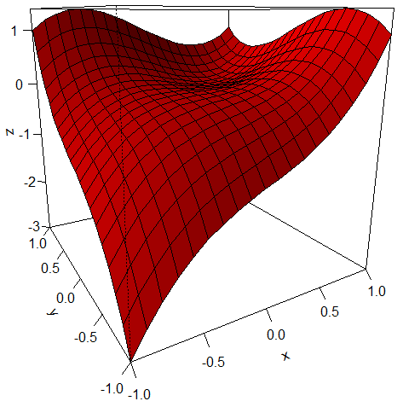
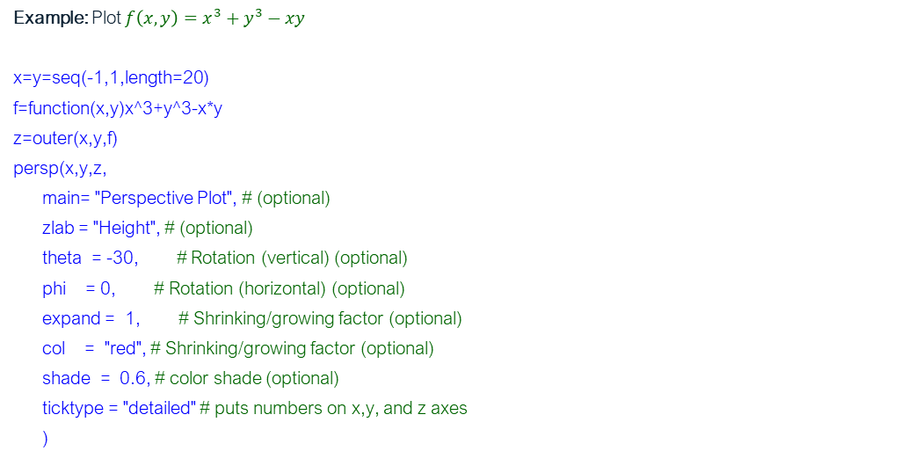
Plotting 3D in R
persp (x,y,z)
Creates a 3D surface graphic for the vectors (x,y,z) where z is a function of x and y defined previously by the “outer” code.
Example: Plot $f\left(x,y\right)=x^{3}+y^{3}−xy$
x=y=seq(-1,1,length=20)
f=function(x,y)x^3+y^3-x*y
z=outer(x,y,f)
persp(x,y,z,
main= "Perspective Plot", # (optional)
zlab = "Height", # (optional)
theta = -30, # Rotation (vertical) (optional)
phi = 0, # Rotation (horizontal) (optional)
expand = 1, # Shrinking/growing factor (optional)
col = "red", # Shrinking/growing factor (optional)
shade = 0.6, # color shade (optional)
ticktype = "detailed" # puts numbers on x,y, and z axes
)

Slide 25
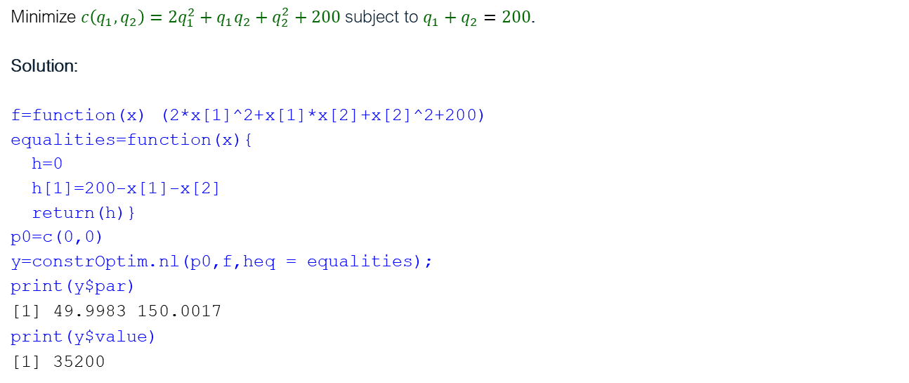
Constrained Optimization
Example: Equality Constraint
Minimize $c\left(q_{1},q_{2}\right)=2q_{1}^{2}+q_{1}q_{2}+q_{2}^{2}+200$ subject to $q_{1}+q_{2}=200$.
Solution:
f=function(x) (2*x[1]^2+x[1]*x[2]+x[2]^2+200)
equalities=function(x){
h=0
h[1]=200-x[1]-x[2]
return(h)}
p0=c(0,0)
y=constrOptim.nl(p0,f,heq = equalities);
print(y$par)
[1] 49.9983 150.0017
print(y$value)
[1] 35200

Slide 26
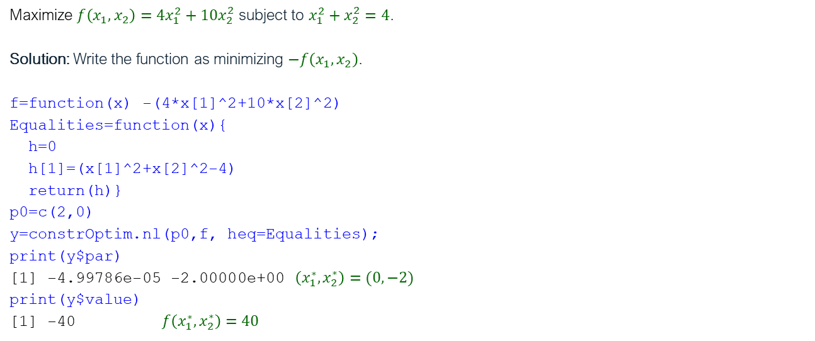
Constrained Optimization
Example: Equality Constraint
Maximize $f\left(x_{1},x_{2}\right)=4x_{1}^{2}+10x_{2}^{2}$ subject to $x_{1}^{2}+x_{2}^{2}=4$.
Solution: Write the function as minimizing $−f\left(x_{1},x_{2}\right)$.
f=function(x) -(4*x[1]^2+10*x[2]^2)
Equalities=function(x){
h=0
h[1]=(x[1]^2+x[2]^2-4)
return(h)}
p0=c(2,0)
y=constrOptim.nl(p0,f, heq=Equalities);
print(y$par)
[1] -4.99786e-05 -2.00000e+00 $\left(x_{1}^{∗},x_{2}^{∗}\right)=(0,−2)$
print(y$value)
[1] -40 $f\left(x_{1}^{∗},x_{2}^{∗}\right)=40$

Slide 27

Constrained Optimization
Example: Inequality Constraint
Maximize $f\left(x_{1},x_{2}\right)=4x_{1}^{2}+10x_{2}^{2}$ subject to $x_{1}^{2}+x_{2}^{2}≤4$.
Solution: Write the function as minimizing $−f$.
f=function(x) -(4*x[1]^2+10*x[2]^2)
inequalities=function(x){
h=0
h[1]= 4-x[1]^2-x[2]^2 #note that h[1] must be positive, i.e., h[1]>=0
return(h)}
p0=c(0,0)
y=constrOptim.nl(p0,f,hin=inequalities);
par: 0.02919113 1.999787
fval: -39.99489

